Slide 1




Slide 2


Agenda
About Percy
Technical Requirements & System Flow
Execution
Result

Slide 3
About Percy

Slide 4
What is Percy?
User-level offer infrastructure. Percy consolidates a customer’s eligible offers and enables automated insertion of offers to relevant communication channels, to further personalize their experience. The channel that will be used to display the offers is through email, which will display the banner that will show the promo code that the user is eligible to.
Percy has different categories of sources, crm, first_time_user, marketing_services, games, and retail, and each would have its own design, message, and promo code.
Marketing Cloud is the platform that Sephora uses to send emails to the subscribers, so Percy has been created as a Dynamic Content Block so each email could have Percy by just including Dynamic Content Block in the email.

Slide 5
Technical Requirements

Slide 6
Technical Requirements
Create automation
Import the Percy Offer Details from FTP(which comes from BQ) to DE
Have fields like offer_id, image, coupon_code, message, and more
Create DCB for email
Make API request to Percy API Endpoint to receive the return of offer details for each user
Pull the image, coupon, message, and more using the offer_id from the API request to the Percy Offer Details DE
Apply the Logic:
Prioritization(crm -> first_time_user -> marketing_service -> games -> retail)
Maximum of 3 banners according to the prioritization.

Slide 7
Execution

Slide 8
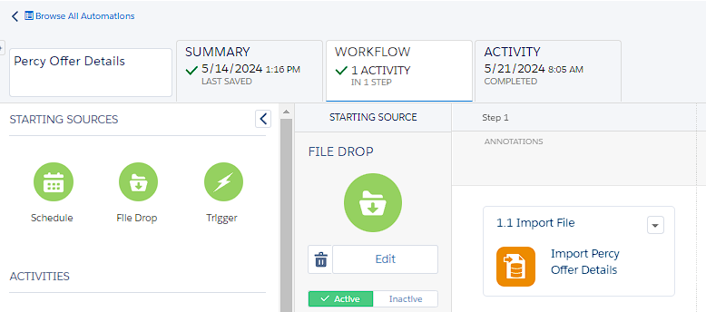
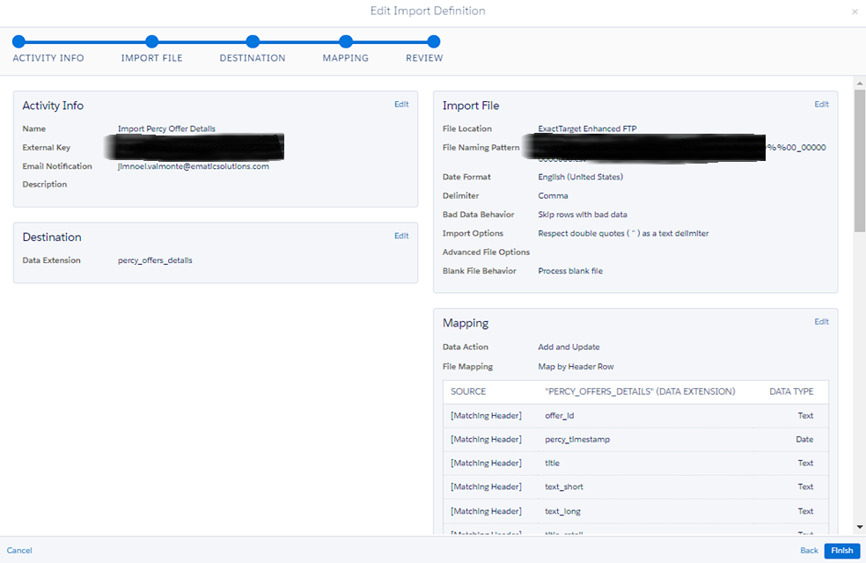
Automation
Handles the process of importing file from FTP that came from BQ. The data contains the offer_id(that will be used to pull the data like image, message, and more from the DE), image, message, coupon_code, and more.
Automation Name: Percy Offer Details
DE: percy_offers_details

Slide 9

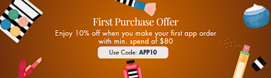
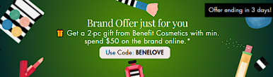
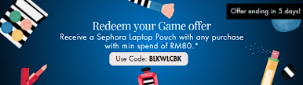
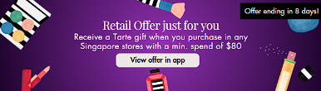
Dynamic Content Block
Contains the code that makes an API request to the Percy Endpoint and manages the return of API request to meet the requirements such as the Banner display, the Logic which are the maximum of 3 banner display, and the display prioritization.
Sample API Return
Percy Offer Details DE(FTP)
DCB
{
"card_number": 6501614168987,
"offers": [
{
"offer_id": "SG_15KVD24_323869_270_20240131",
"eligibility_source": "marketing_services",
"offer_score": 0.85,
"user_start_timestamp": null,
"user_end_timestamp": null,
"has_qualifier": true,
"brand_id": 270,
"gwp_brand_id": null
},
{
"offer_id": "SG_NUDIES20_322986_271_20240215",
"eligibility_source": "marketing_services",
"offer_score": 0.65,
"user_start_timestamp": null,
"user_end_timestamp": null,
"has_qualifier": true,
"brand_id": 271,
"gwp_brand_id": null
}
]
}
offer_id
text_short
coupon_code
img_landscape
offer_start_timestamp
offer_end_timestamp
offer_source
min_spend
offer_source = crm
offer_source = first_time_user
offer_source = marketing_services
offer_source = games
offer_source = retail

Slide 10
Locations
Automation
Business Unit: Parent
Name: my automations / Percy / Percy Offer Details
DE: percy_offers_details
Dynamic Content Block
Business Unit: Singapore
Name: Content Builder > Dynamic_Content_Blocks > Active DCB > API Call > sg_dcb_api_marketingservices_offers

Slide 11
Result

Slide 12
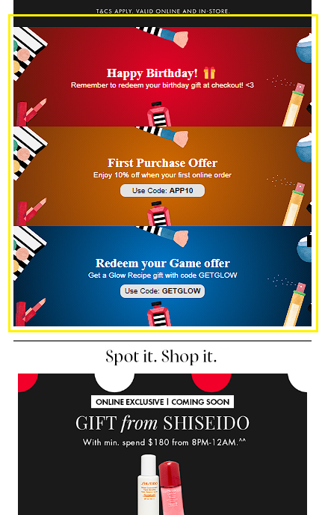
Preview & Test
Card Number: 6501481035948

Slide 13

THAT’S IT! THANK YOU!

